Slide 1






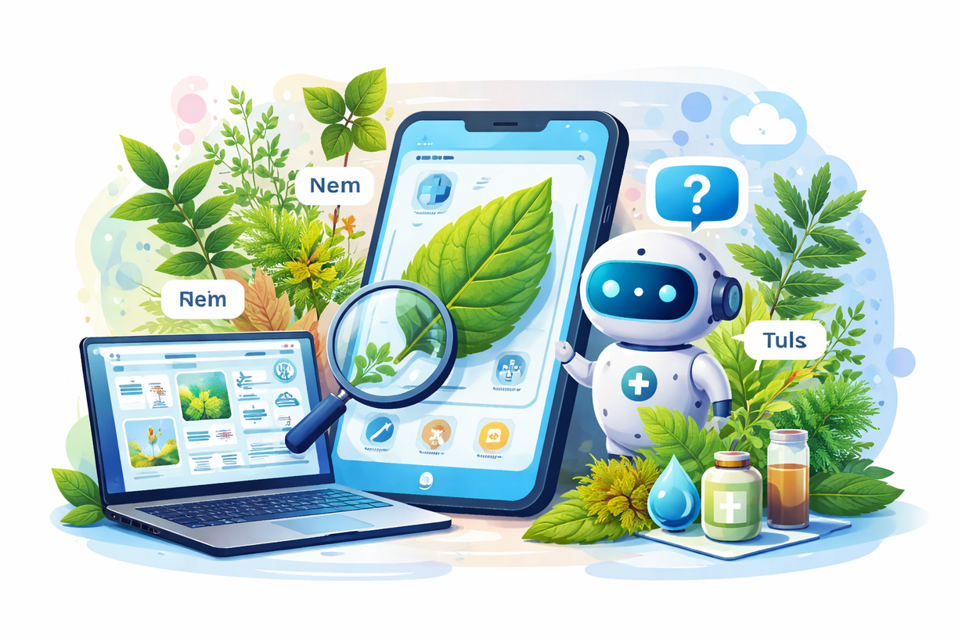









Medicinal Leaf Classification with Integrated Chatbot
Neem
PRESENTATION 2026
Student Name
Student Email
Guide
D.Harini
D.Sri Varshini
B.Harshitha
P.Karthika
dasariharini07@gmail.com
yashuc649@gmail.com
harshithabadithamani@gmail.com
karthika.perambuduri10@gmail.com
Rapaka Manoj Kumar(SME)

Slide 2


OUTLINE
Abstract of the Project
Problem Statement
Proposed Solution
System Architecture
Live Demo of the Project
Embedded Video of Project
Conclusion
Future Scope
Notes:
2

Slide 3
Abstract
Identification of medicinal plants is essential in traditional healthcare, but manual identification is time-consuming and requires expert knowledge. This project presents an intelligent system for medicinal leaf classification using transfer learning–based Convolutional Neural Networks (CNNs). Leaf images are preprocessed and classified accurately using a trained deep learning model. An integrated AI chatbot provides user-friendly information on the identified plant, including its medicinal uses and benefits. The system is implemented using a Streamlit web interface for real-time prediction and interaction. The proposed solution combines computer vision and natural language processing to improve accessibility, reduce expert dependency, and support applications in healthcare, education, and agriculture.

Slide 4


Problem Statement
Manual identification of medicinal plants requires expert knowledge and is often time-consuming and error-prone. Existing systems lack accurate image-based recognition and interactive explanations. Hence, an automated system is needed to classify medicinal leaves from images and provide meaningful medicinal insights through an integrated chatbot.

Slide 5

Proposed Solution
The proposed system automatically identifies medicinal plant leaves from uploaded images using a deep learning–based CNN model. The image is processed and classified to predict the plant species accurately. After identification, the system displays the plant name and its medicinal benefits. An AI chatbot is also integrated to provide simple and interactive explanations. The complete system is developed as a real-time web application using Streamlit for easy user interaction.

Slide 6

System Architecture
Image Input & Interface
Image Preprocessing
The system allows users to upload medicinal leaf images through a user-friendly web interface developed using Streamlit. This interface acts as the entry point of the system and enables real-time interaction between the user and the application.
The uploaded image is resized and normalized to match the input requirements of the deep learning model. Preprocessing ensures consistent image quality and improves the accuracy of feature extraction during classification.
Leaf Classification Model
Chatbot & Result Display
A transfer learning–based Convolutional Neural Network (CNN) processes the preprocessed image to extract important visual features. The trained model analyzes these features and predicts the corresponding medicinal plant class with high accuracy.
Once the leaf is identified, the system displays the plant name along with its medicinal benefits. An integrated AI chatbot further provides interactive explanations and answers user queries related to the identified plant.

Slide 7
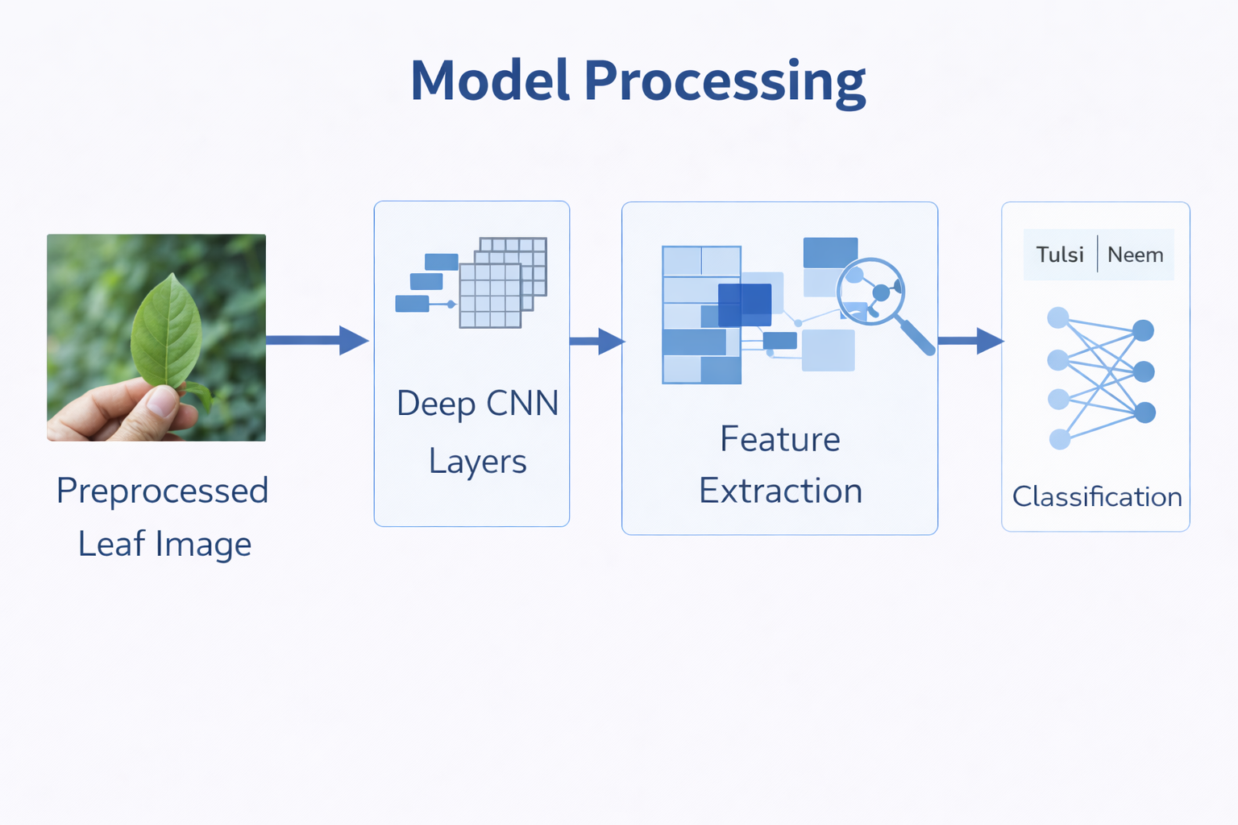

Slide 8
ALGORITHM USED
CNN with Transfer Learning
This project uses a Convolutional Neural Network (CNN) for medicinal leaf classification.
Transfer learning is applied using a pre-trained model to improve accuracy and reduce training time.
The model automatically learns important leaf features such as shape, texture, and vein patterns.
Why this approach?
High accuracy
Faster training
Efficient with limited data

Slide 9
Working of the Algorithm
The user uploads a medicinal leaf image through the web application.
The image is resized and preprocessed to match the model input format.
The pre-trained CNN extracts important features from the image.
The extracted features are passed through classification layers.
A Softmax function predicts the most probable plant class.
The final output displays the plant name along with its medicinal benefits.
This algorithm enables accurate and real-time classification of medicinal plant leaves.

Slide 10
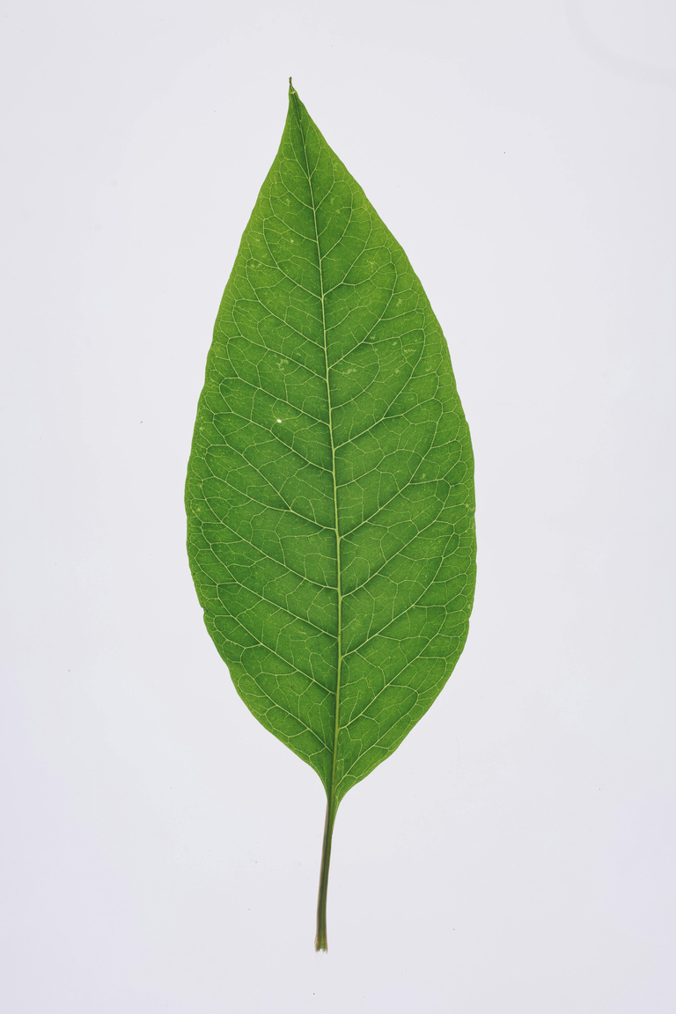





Live Demo of Project
Image Upload
Model Processing
Prediction Result
User selects and uploads a medicinal leaf image through the Streamlit-based application interface. The uploaded image is displayed on the screen and prepared for analysis by the system.
The system preprocesses the uploaded leaf image and passes it to the trained transfer learning–based CNN model. The model extracts visual features and performs classification to identify the medicinal plant
The system predicts the medicinal leaf category and displays the identified plant name along with its medicinal benefits. The integrated AI chatbot further provides interactive explanations based on user queries.

Slide 11
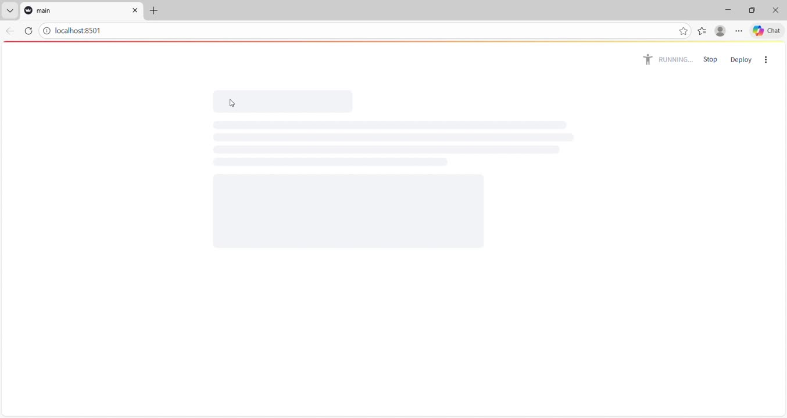
Video of Project Demo

Slide 12
Insights & Recommendations
Transfer learning–based CNN models perform well for medicinal leaf classification, even with a limited dataset.
Image preprocessing and data augmentation help improve prediction accuracy and model reliability.
The system is able to provide fast and real-time predictions through a web interface.
Displaying medicinal benefits along with classification increases the practical value of the system.
Increase the dataset size by adding more medicinal plant species and image variations.
Use clear, well-lit leaf images to achieve better classification accuracy.
Validate medicinal information using trusted herbal or medical sources.
Extend the system to support mobile and multilingual access for wider usability.

Slide 13

Conclusion
The proposed system automatically identifies medicinal plant leaves from uploaded images using a deep learning–based CNN model. The image is processed and classified to predict the plant species accurately. After identification, the system displays the plant name and its medicinal benefits. An AI chatbot is also integrated to provide simple and interactive explanations. The complete system is developed as a real-time web application using Streamlit for easy user interaction.

Slide 14

Future Scope
Increase the dataset by adding more medicinal plant species
Develop a mobile application for real-time leaf identification
Extend the system to detect plant diseases and leaf health conditions
Add multilingual support for wider accessibility
Deploy lightweight models for offline and edge-device usage

Slide 15
Thank You
Notes:
thank you very much for joining this PPT, keep learning.
13

